Slide 1
AWS Organization & Organizational Units

Slide 2
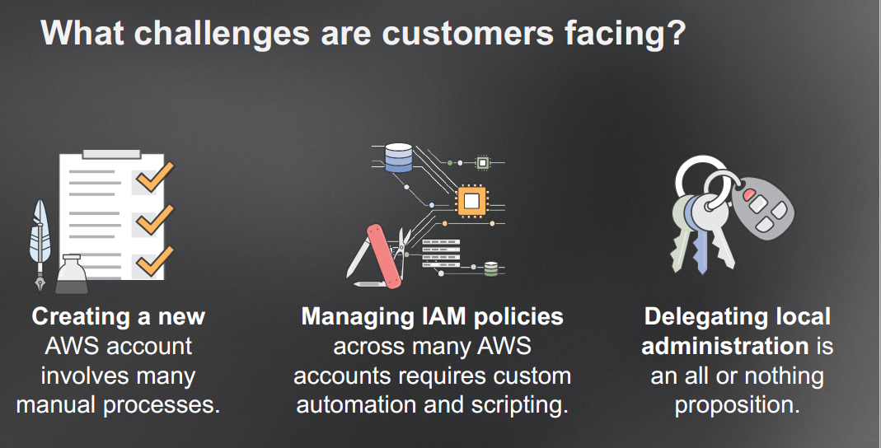

Slide 3
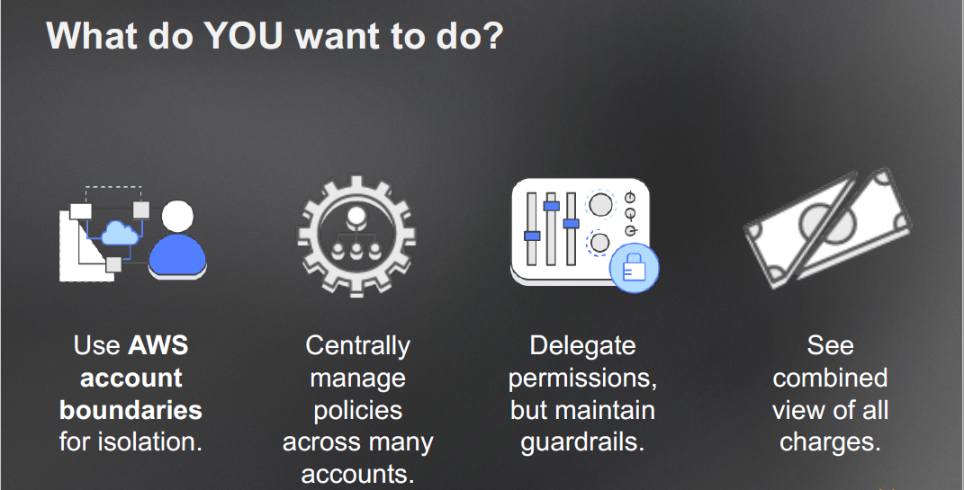
This is what we at EMXCEL want to do

Slide 4
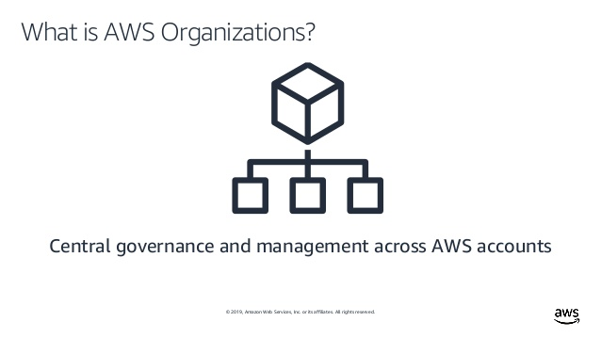

Slide 5
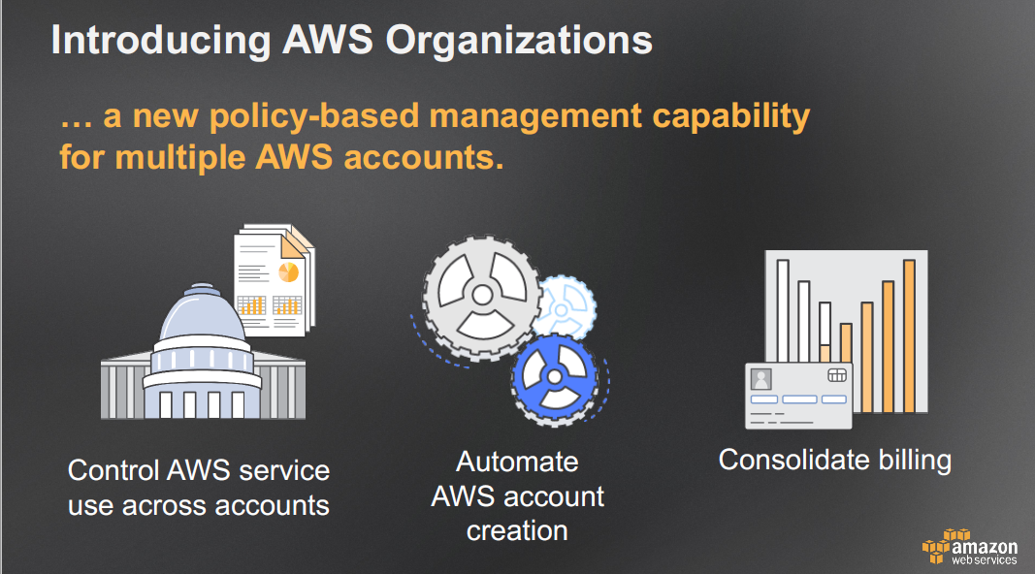

Slide 6
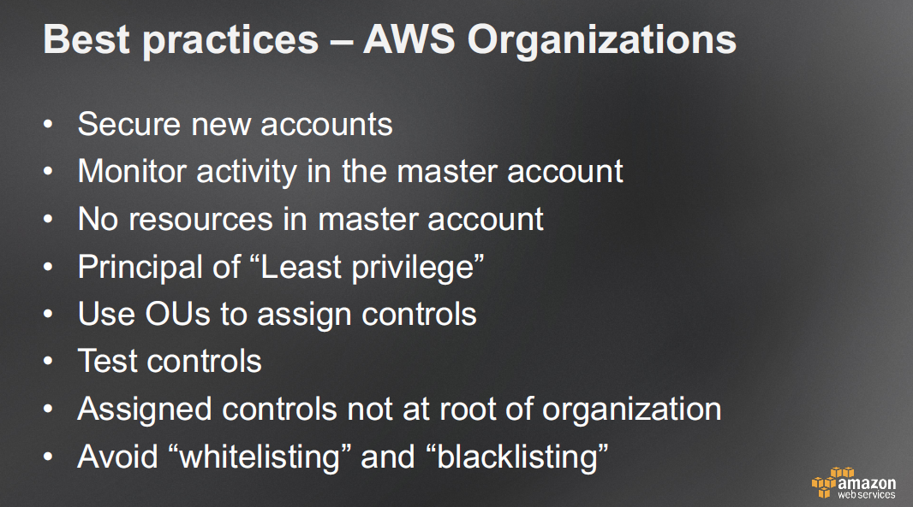
AWS Organization gives you a new policy-based management capability for multiple AWS accounts and helps you solve all these points.

Slide 7
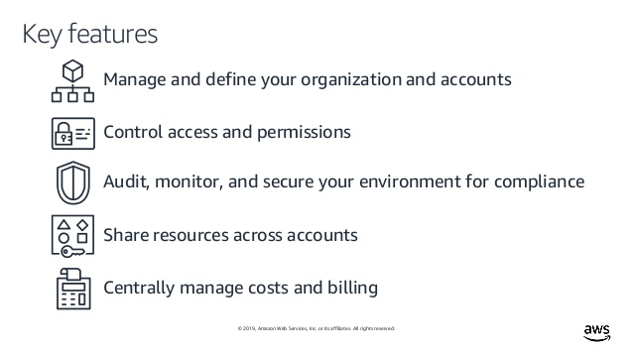

Slide 8
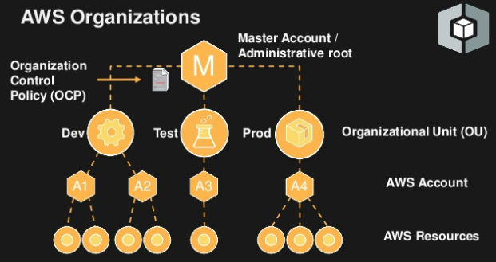
Hierarchical representation of AWS Organization along with OUs

Slide 9
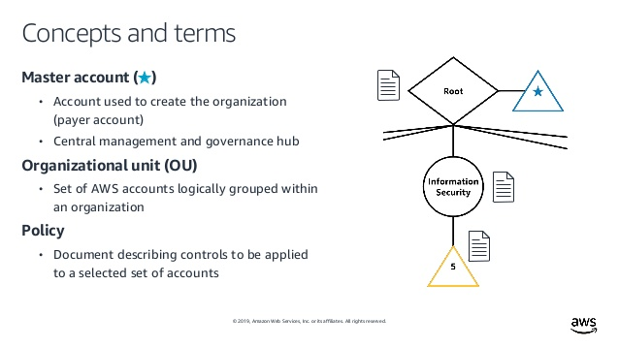

Slide 10
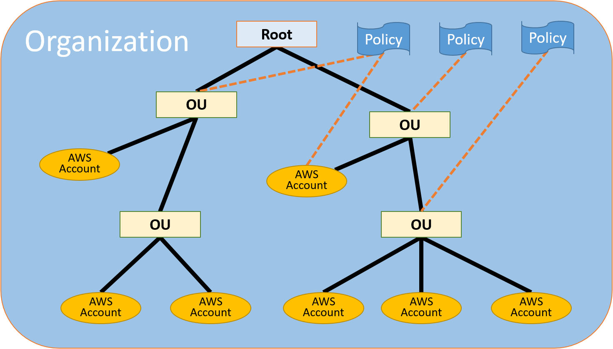
Same like this image , we are considering overall 3-4 Organizational Units.
In the normal Practice, we can avoid creating instances for only front-end applications & directly using AWS Cloud front with CDN features.

Slide 11
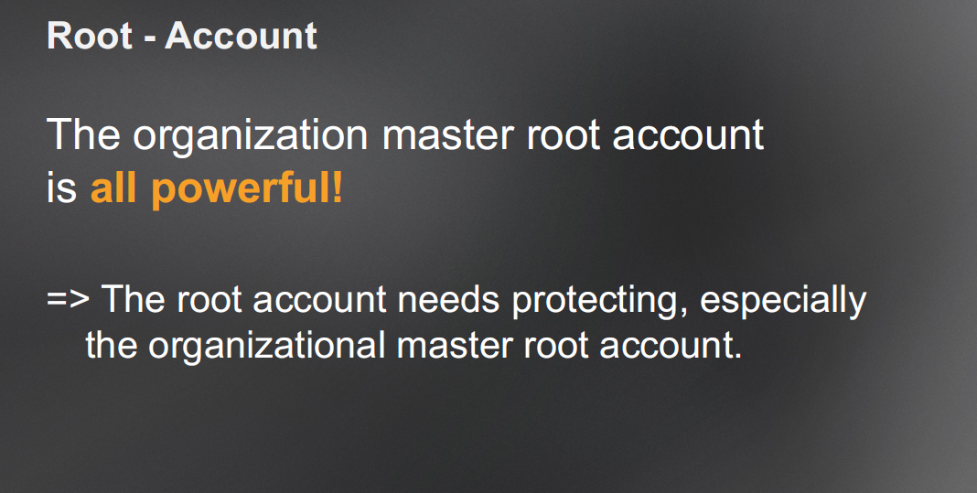
Types of Accounts in AWS Organization

Slide 12
Types of Accounts in AWS Organization
There are two types of accounts in an organization:
a single account that is designated as the master account (root), and member accounts.
The master account is the account that creates the organization.
From the organization's master account, you can follow below steps:
Create accounts in the organization
Invite other existing accounts to the organization
Remove accounts from the organization
Manage invitations
Apply policies to entities (roots, OUs, or accounts) within the organization
Invitation for member accounts:
An invitation can be issued only by the organization's master account. The invitation is extended to either the account ID or the email address that is associated with the member account. After the invited account accepts an invitation, it becomes a member account in the organization.

Slide 13
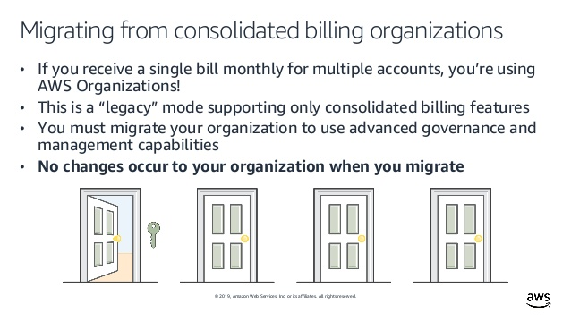
Consolidated Billing Feature inside AWS Organizations

Slide 14
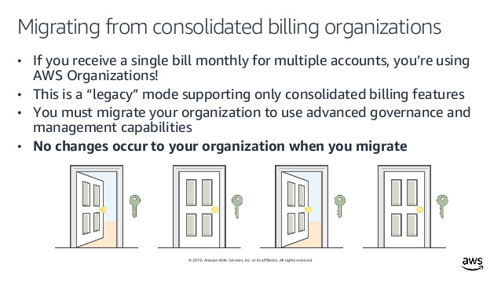
Consolidated Billing Feature inside AWS Organizations (cont)

Slide 15
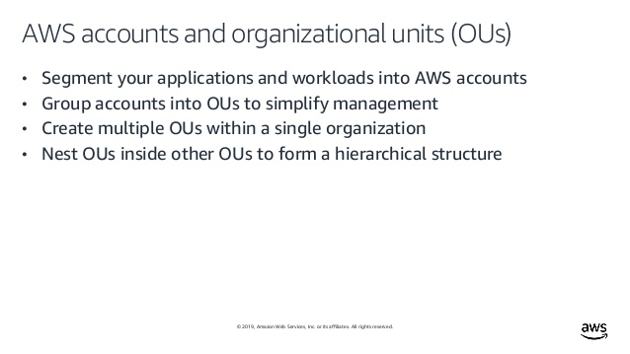
AWS Organizational Units (OUs)

Slide 16
Standard Details of having Organizational Units (OUs):
Multiple members account will be further linked to one or more Organization Units as mentioned below.
Primarily we are planning to have 3 Organization Units (OU)
Development / Staging, UAT and Production and in the below level the members account will be distributed based on the nature of the account.
You can attach a policy-based control to an OU, and all accounts within the OU automatically inherit the policy.
You can create multiple OUs within a single organization, and you can create OUs within other OUs. Each OU can contain multiple accounts,
You can move accounts from one OU to another. However, OU names must be unique within a parent OU or root.
AWS recommends that you start with security and infrastructure in mind which is covered in Foundational OUs
There are several types of OU segregation based on the need of Organization as below:
Foundational OUs
Additional OUs

Slide 17
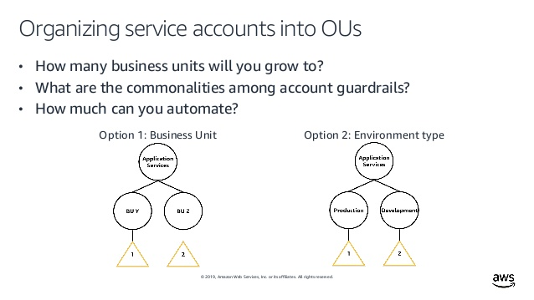
Service Account Management

Slide 18
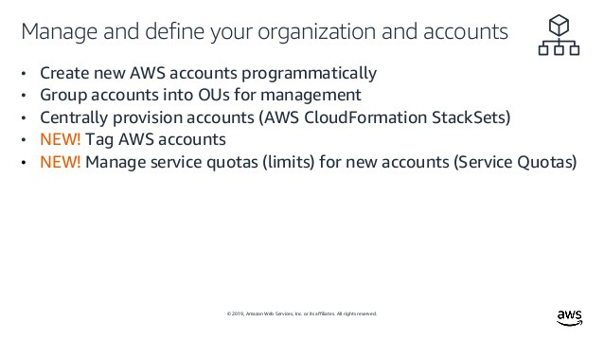
Management of accounts in AWS Organization

Slide 19
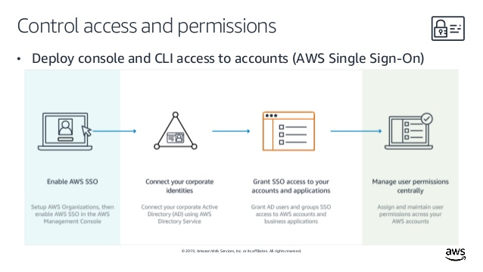

Slide 20
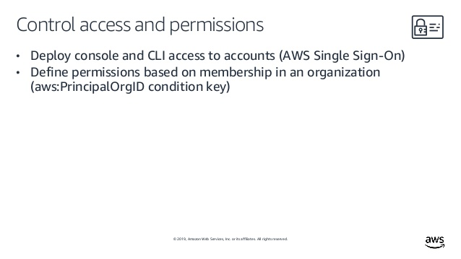

Slide 21
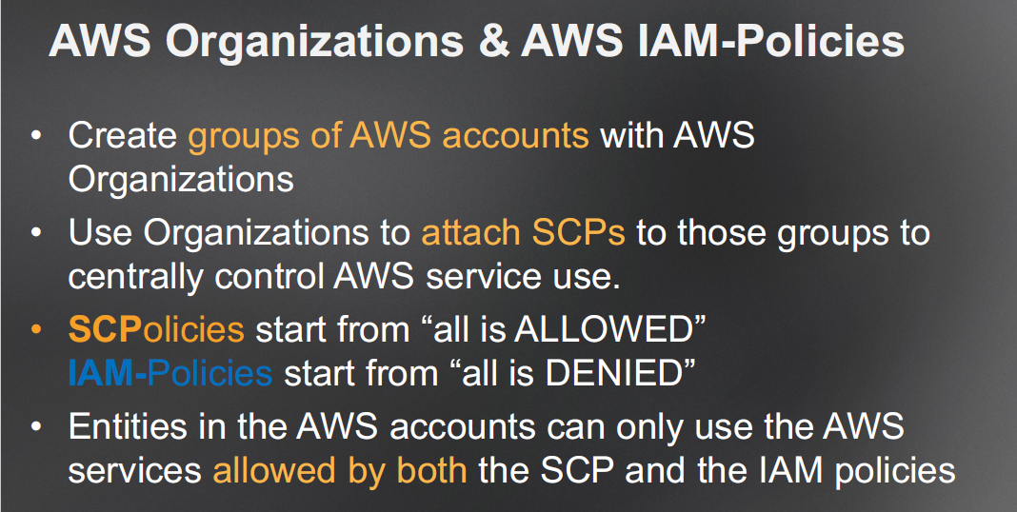

Slide 22
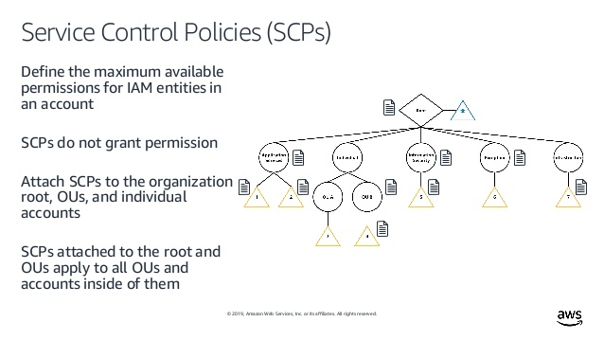

Slide 23
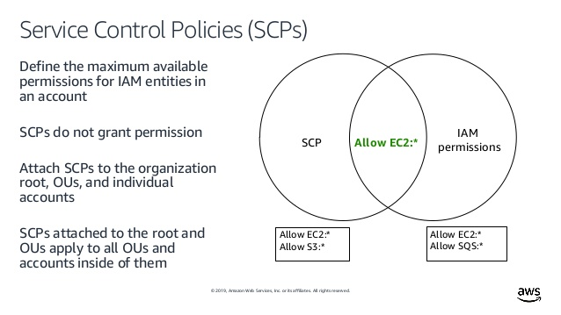

Slide 24
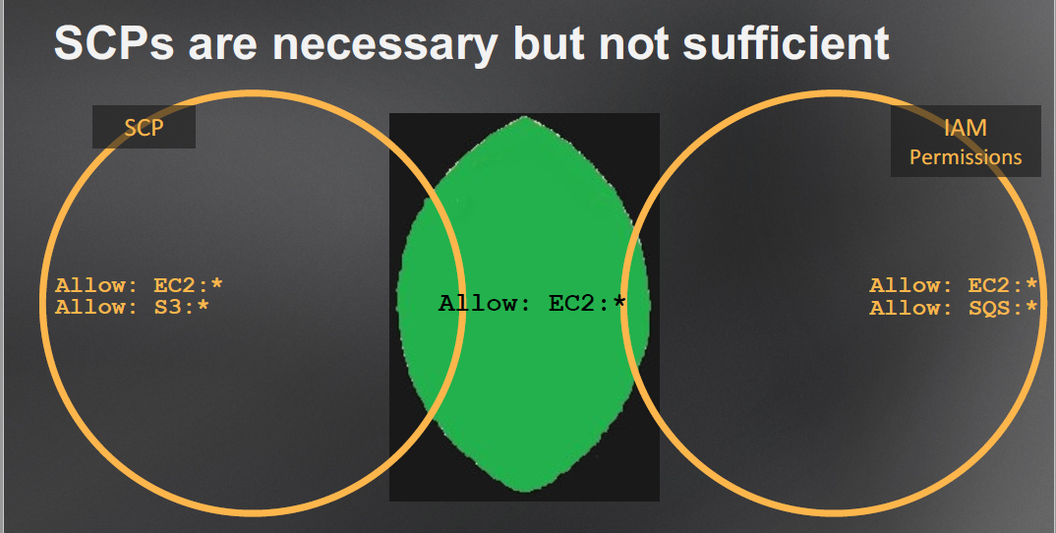
Service Control Policies

Slide 25
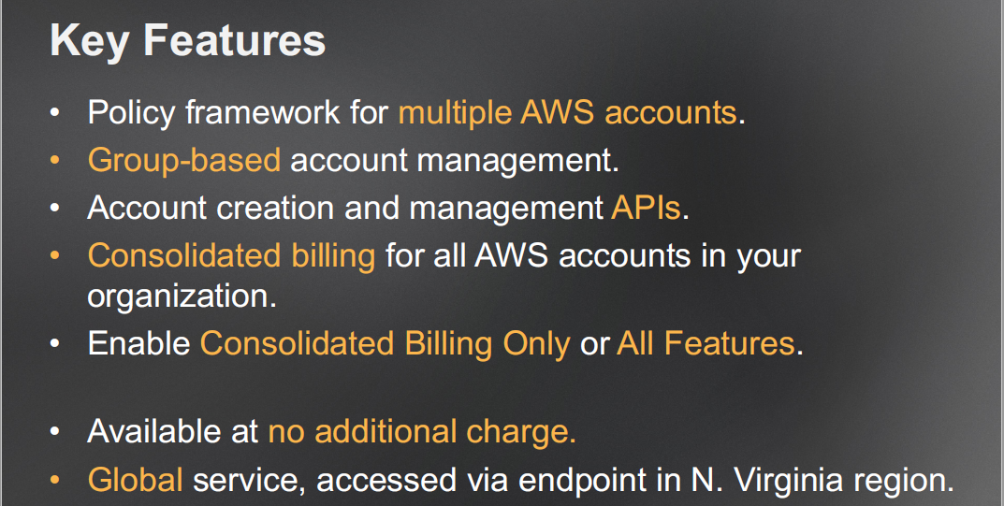
Key Features of IAM based Service policies in AWS Organization

Slide 26
To Plan & Create service control policies:
- select the policies for Organization & accounts in such a way that it will have granular level of access for the list of users in a simple manner.
- Create policy based on the access roles given to the users
- OUs are to be created based on the Business Units and even service policy roles are being created by considering the Business Units (development team, QA Team, DBA team, Devops Team, Technical Architect / Leads)
- Primarily there will be 4 levels of access roles to be considered in Organization across all accounts
Developers - very basic and limited access to be provided with only required execution rights
Architects / leads - limited read-only & execution access on the required resources
DBA - limited execution and read/write access only for database related resources
DevOps - administrator level access having full access of Read/Write on almost all resources
- Consider to enable 2FA for each and every user to login to the console of AWS resources to make sure of secure authorization while doing access control.
- Service policies will be designed to strengthen the security and managing operations easily.

Slide 27
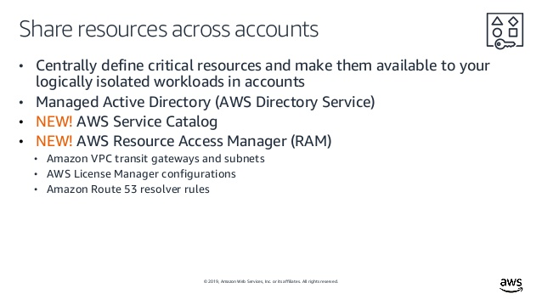
Shared Resources

Slide 28
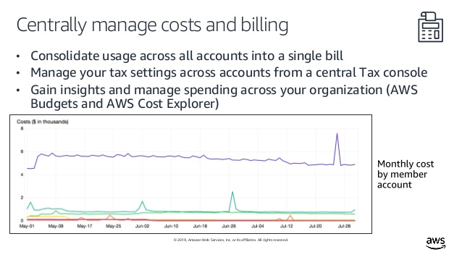

Slide 29
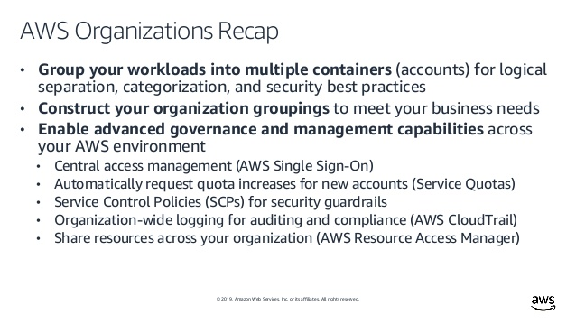

Slide 30
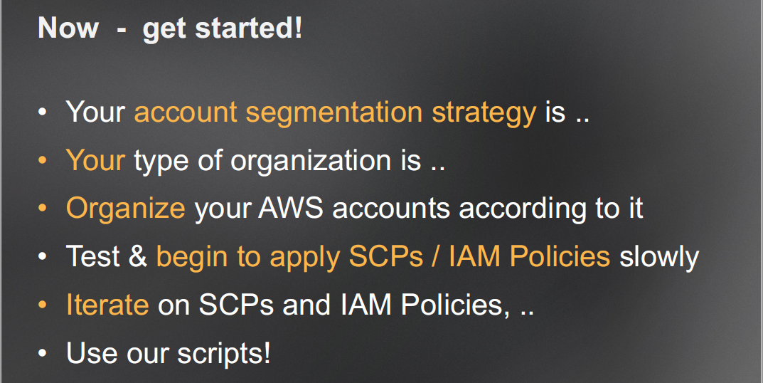
Start with the Implementation of AWS Organization & OUs

Slide 31
Thank You

